Slide 1
Financial Computing Master Performance Testing 4th December

Slide 2
Content
1
Why performance testing? Why applications become slow? Client feedback.
1
The benefits of the Performance Testing
Types of testing
2
Types of testing
2
Differences between Functional and Load Testing
3
Differences between Functional and Load Testing
3
4
4
Performance Testing – definition
Performance Testing – definition
Types of Performance Testing
5
Types of Performance Testing
5
6
Performance testing execution: Scripts, Parameters, Execution patterns, Graphs, Tools
6

Slide 3

Why performance testing?
To discover application’s potential bottlenecks.
To identify the number of users that can access your application without a heavy degradation of the user experience.
To find out the breaking points of the application.
To find out the behavior of the application under load.
To check the amount of time it takes for your server to respond to clients if your website loads up.
To understand if the connections to the database represent a bottleneck in your application.
To identify if the performance behavior of the application is influenced badly after the changes done in each release.
To discover the count of parallel users your website can handle.

Slide 4
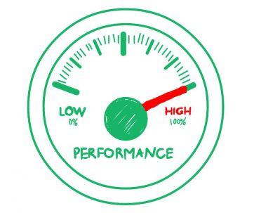
Why applications become slow?
APPLICATION COMPLEXITY
APPLICATION DESIGN
APPLICATION TESTING
THE BUTTERFLY EFFECT
THE WEB BROWSER
CONFIGURATION CHANGES
PEAK USAGE
PEOPLE COMMUNICATION
THE UNKNOWN UNKNOWNS

Slide 5
Client feedback
Is there any risk if we plan for a Platform and Data Center migration
Can we still meet the Fed deadline if we double our data feeds?
Will our web site support 10,000 concurrent users and can we guarantee that we won’t lose clients due to slow response?
Will our system support future Peak volumes and catastrophic market events?
Identify Performance and Stability issues and drive issue resolution prior to production deployment
PROACTIVE
Application response time is very high in Hong Kong
Users cannot log in the system at the first hour in the morning
I can see a critical error on the screen. Is my data processed?
REACTIVE

Slide 6
Content
1
Why performance testing? Why applications become slow? Client feedback.
2
Types of testing
3
Differences between Functional and Load Testing
4
Performance Testing – definition
5
Types of Performance Testing
6
Performance testing execution: Scripts, Parameters, Execution patterns, Graphs, Tools

Slide 7
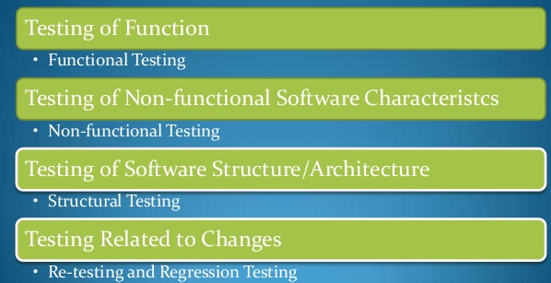
Type of testing (ISTQB)

Slide 8
Content
1
Why performance testing? Why applications become slow? Client feedback.
2
Types of testing
3
Differences between Functional and Load Testing
4
Performance Testing – definition
5
Types of Performance Testing
6
Performance testing execution: Scripts, Parameters, Execution patterns, Graphs, Tools

Slide 9
Differences between Functional and Non-Functional Testing (1)
Functional Testing
Objective | Example
Functionality | Do business processes function properly after implementation?
Non-Functional
Objective | Example
Stability | Will 2,000 concurrent hits crash the server?
Performance | Is response time acceptable according to specifications?
Functionality under load | Do business processes function properly under heavy load?
A login request shall be responded to in 1 second or less under a typical daily load of 1,000 requests per minute.

Slide 10
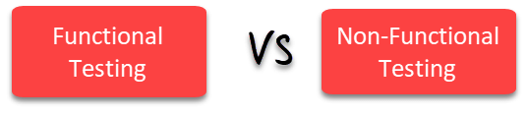
Differences between Functional and Non-Functional Testing (2)
Parameters | Functional | Non-functional testing
Execution | It is performed before non-functional testing. | It is performed after the functional testing.
Focus area | It is based on customer's requirements. | It focusses on customer's expectation.
Requirement | It is easy to define functional requirements. | It is difficult to define the requirements for non-functional testing.
Usage | Helps to validate the behavior of the application. | Helps to validate the performance of the application.
Objective | Carried out to validate software actions. | It is done to validate the performance of the software.
Requirements | Functional testing is carried out using the functional specification. | This kind of testing is carried out by performance specifications
Manual testing | Functional testing is easy to execute by manual testing. | It's very hard to perform non-functional testing manually.
Functionality | It describes what the product does. | It describes how the product works.
Example Test Case | Check login functionality. | The dashboard should load in 2 seconds.

Slide 11
Content
1
Why performance testing? Why applications become slow? Client feedback.
2
Types of testing
3
Differences between Functional and Load Testing
4
Performance Testing – definition
5
Types of Performance Testing
6
Performance testing execution: Scripts, Parameters, Execution patterns, Graphs, Tools

Slide 12
Performance Testing – definition
Performance testing is defined as the technical investigation done to determine or validate the speed, scalability, and/or stability characteristics of the product under test.
The purpose of the performance testing is to measure characteristics, such as response times, throughput or the mean time between failures (for reliability testing).
The goal of performance testing is not only find the bugs in the system but also eliminate the performance bottlenecks from the system.

Slide 13
Content
1
Why performance testing? Why applications become slow? Client feedback.
2
Types of testing
3
Differences between Functional and Load Testing
4
Performance Testing – definition
5
Types of Performance Testing
6
Performance testing execution: Scripts, Parameters, Execution patterns, Graphs, Tools

Slide 14


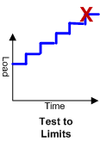
Performance Testing Types Nomenclature (1)
Name | Description | Load Profile
Load | Designed to verify response time & throughput at peak anticipated production workload meet expectations: After a discovery and analysis process that yields the appropriate workloads for your system, we design a test that represents the anticipated normal peak workload. We then apply that workload so that we can measure the system’s ability to process that workload.
Endurance | Designed to validate stability, durability, reliability, and availability over an extended duration: After a discovery and analysis process that yields the appropriate workloads for your system, we design a test that represents the anticipated workload. We then apply that workload for an extended period so that we can measure the system’s ability to process that workload over that time.
Scalability | Designed to verify system’s ability to process increasing workloads above anticipated peak up to a defined limit: After a discovery and analysis process that yields the appropriate workloads for your system, we design a test that will increase in load over time. We then apply that test design until we reach our desired plateau so that we can measure the system’s ability to process those levels of load.
Capacity | Designed to verify system’s ability to process increasing workloads above anticipated peak up to a breakpoint: After a discovery and analysis process that yields the appropriate workload for your system, we design a test that will continue to increase in load overtime until a breakpoint is reached. We then apply that test design so that we can measure the system’s behavior as it approaches and reaches that breakpoint.

Slide 15
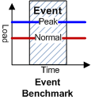

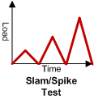
Performance Testing Types Nomenclature (2)
Name | Description | Load Profile
Benchmark | This test establishes system behavior prior to system changes for an engagement
Smoke | A test at low-load to show the readiness of our Performance Engineering infrastructure
Event | Designed to verify system’s ability to perform as expected before and after predictable but atypical events: After a discovery and analysis process that yields the appropriate workloads for your system, we design a test that represents the appropriate workload. We then apply that workload and initiate an event so that we can measure the system’s ability to survive and recover from that event.
Spike | Designed to verify system’s ability to sustain a burst of activity significantly above the expected peak workload: After a discovery and analysis process that yields the appropriate workloads for your system, we design a test that represents short bursts of high activity level in the workload. We then apply that workload so that we can measure the system’s ability to absorb the erratic usage pattern.

Slide 16
Content
1
Why performance testing? Why applications become slow? Client feedback.
2
Types of testing
3
Differences between Functional and Load Testing
4
Performance Testing – definition
5
Types of Performance Testing
6
Performance testing execution: Scripts, Parameters, Execution patterns, Graphs, Tools

Slide 17
Performance testing execution: Scripts, Parameters, Execution patterns, Graphs , Tools
Scripts
Initialization
Open connection - Login
Iteration – Action (s) – Use case(s)
Transaction(s) – Request(s)
Think Time
Exit
Closing connection(s) - Logout
Transaction(s) – Request(s)

Slide 18
Performance testing execution: Scripts, Parameters, Execution patterns, Graphs , Tools
Parameters (data)
Static
Dynamic
File
Query
Random
Date
XML
Captured
Coded
Generated

Slide 19
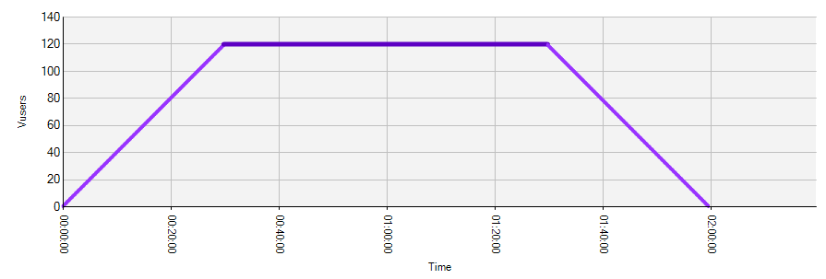
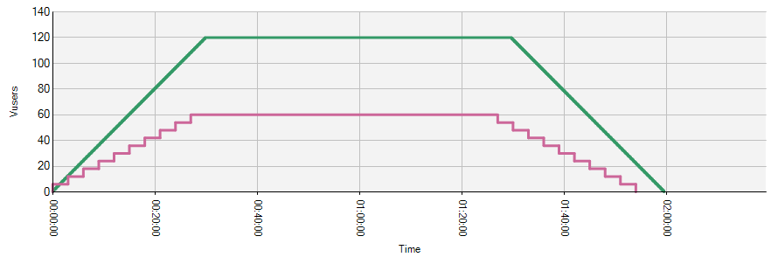
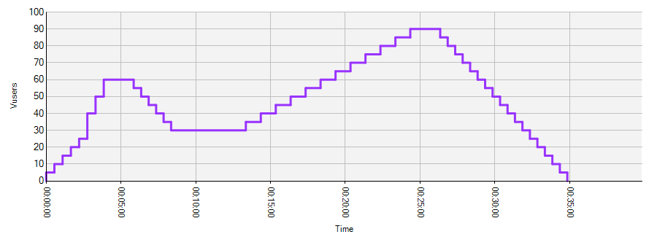
Performance testing execution: Scripts, Parameters, Execution patterns, Graphs , Tools
Execution patterns

Slide 20
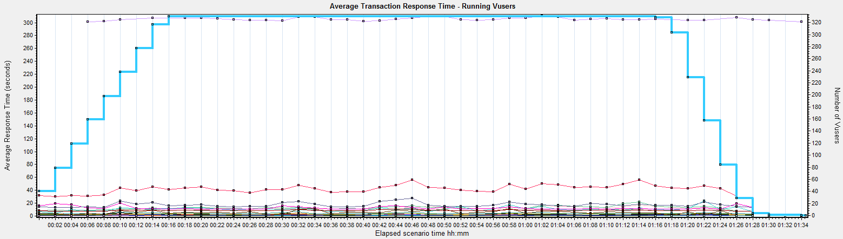
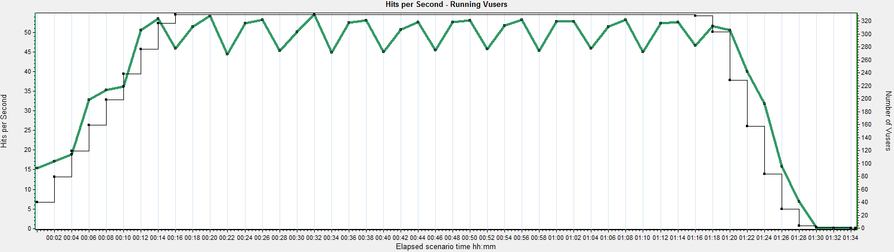
Performance testing execution: Scripts, Parameters, Execution patterns, Graphs , Tools
Typical performance graphs

Slide 21
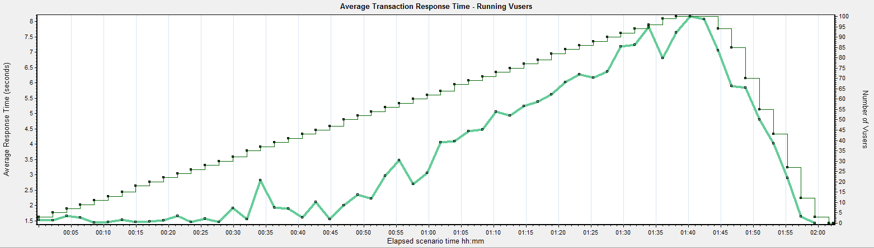
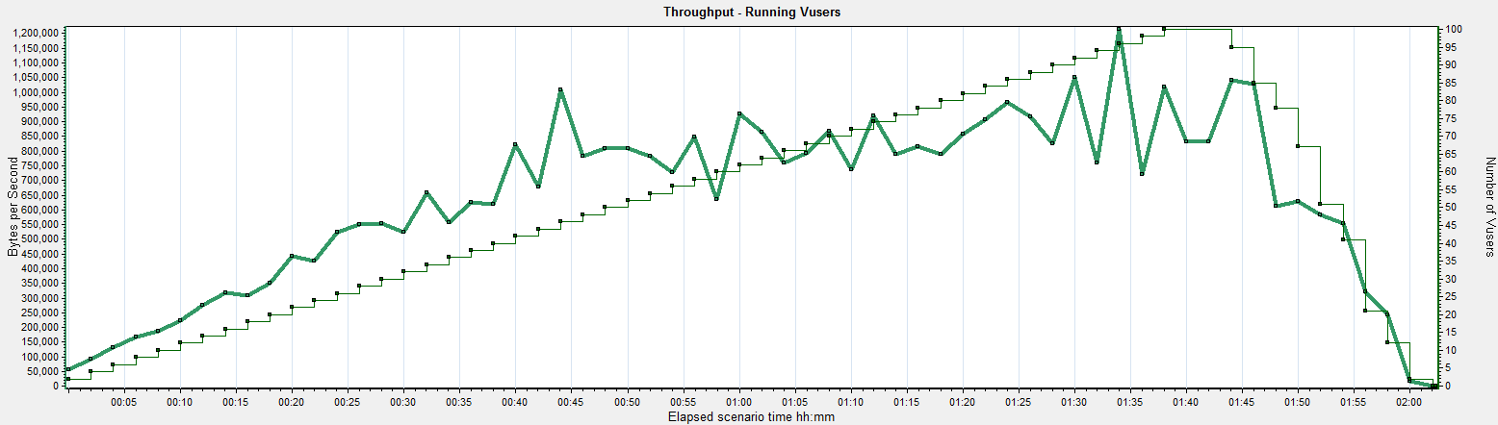
Performance testing execution: Scripts, Parameters, Execution patterns, Graphs, Tools
Typical defects graphs

Slide 22
Performance testing execution: Scripts, Parameters, Execution patterns, Graphs, Tools
Typical defects graphs

Slide 23
Performance testing execution: Scripts, Parameters, Execution patterns, Graphs, Tools
Tools
Freeware Performance Test Tools (JMeter, Grinder, OpenSTA, Tsung, WebLOAD):
Open source and free
Specialist knowledge required – Developer level interest required to learn.
Learning Curve: High
Development Time: High
Handover Time: High
No commercial support: Reliance on forums and goodwill
Best Suited To: In-house, subsystem testing, ‘quick and dirty’ testing, have high access to insider knowledge of application under test.
Commercial Performance Test Tools (Loadrunner, SilkPerformer, Forecast):
All in one packages: A lot of what you need is included in these packages. e.g. Record and playback functionality, analyst graphs, monitoring capability, debugging ability
Costs involved
Learning Curve: Medium
Development Time: Med
Handover Time: Med
Commercially supported – protocols updates available quickly, help for issues and fixes can be speedy
Best Suited To: In-house testing of applications prior to release where aggressive releases and builds are scheduled.

Slide 24
Financial Computing Master Performance Testing QA

